Slide 1



Deliver consistent earnings growth, underpinned by a strong risk culture
AML Compliance
Presented by

Slide 2

Our Experts
Project Manager
Hardik Dhakan
Associate Project Manager
Ashna Ashraf
Business Analyst
Aiswarya Dinesh
Data Associate
Shashwat Bhatt
Process Associate
Saurav Joy

Slide 3

About Us
Insights is an IT Consulting firm that has a dedicated team specializing in a wide range of services in Information Technology.
Focus -
Artificial Intelligence
Big Data
Cloud Solutions
Hardware/Software
Data Analytics

Slide 4


Product Enhancement
Opportunity
To Improve AML Compliance at TD using AI solutions.
Key Areas Targeted:
Transaction Monitoring
Regulatory Reporting
Employee Training

Slide 5
Mission
Strategy
As a top 10 North American bank, TD aims to stand out from its peers by having a differentiated brand – anchored in our proven business model, and rooted in a desire to give our customers, communities, and colleagues the confidence to thrive in a changing world.
Proven business model
Deliver consistent earnings growth, underpinned by a strong risk culture.
Forward Focused
Shape the future of banking in the digital age.
Vision
To be the better bank
Purpose
To enrich the lives of customers, communities and colleagues.

Slide 6
Problem Statement
TD stocks have seen the highest short positions in April 2023
Why?
Investments in Canadian Housing
Acquisition of Charles Schwab ( 36 percent decline)
First Horizon merger cancelled (US Regulatory Probe)
Concerns from US regulators:
Front Staff Employee Practices
Transaction Reporting Concerns
Deficient AML controls
Delays in Compliance Reporting and Regulatory Approvals

Slide 7
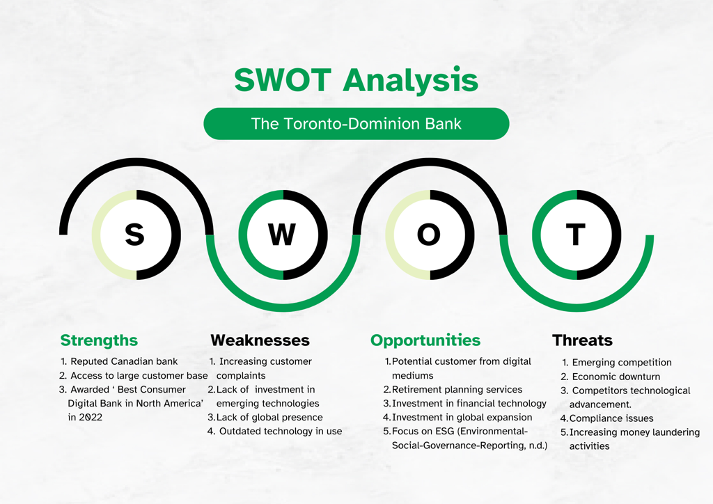
SWOT

Slide 8
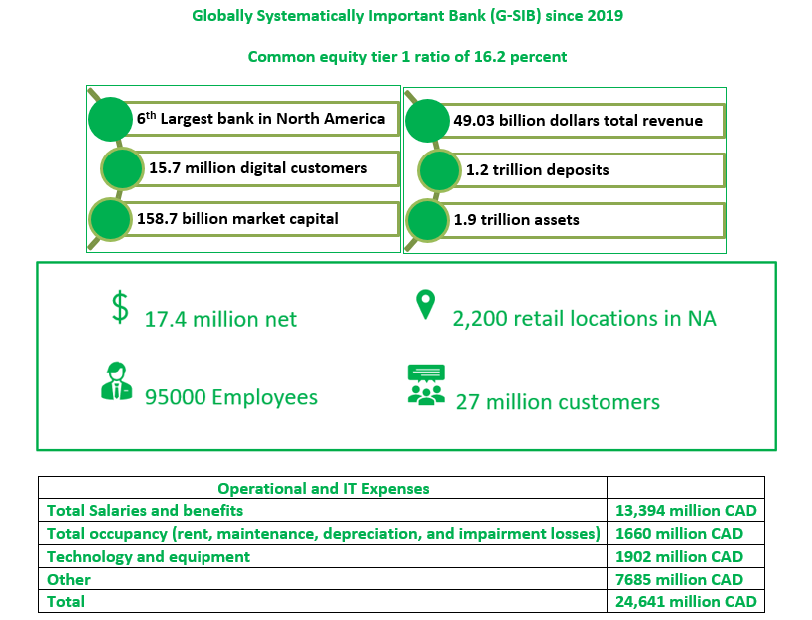
TD – Financial Measures

Slide 9
Current State:
Market Capitalization Decline
High Shorting of TD Stock
US Department of Justice Probe on AML Compliance
Decrease in Net Income
Need for Enhanced AML Detection
01.
Transition Requirements
Plan:
1. Analyzing current processes
2. Review Regulations
3. Risk Analysis
4. Analyze Customer Behaviour
5. Provide AML training to internal employees
6. Implement advanced AML technology (Generative AI, Machine Learning, AML vendors, or alternatives)
7. Maintain documentation
8. Vendor assessment (if applicable)
9. Internal Audits
10. Co-operation with US regulators
11. Continually review and improve processes (flexibility)
02.
Future State with AI Technology:
Improved Fraud and Money Laundering Detection
Higher Detection Rates
Reduction in Fines and Penalties
Strengthened Financial Position
03.
Transitional State and Solutions:
Diversification and US Business Growth
Gap in AML Compliance Processes
Research for Best AML Improvement Methods
Consideration of AI, Third-Party Software, In-house Solutions
Training and Resources for AML Team
Emphasis on AI in Detecting Money Laundering

Slide 10
Project Scope
The project aims to develop and implement an AI-based Anti-money laundering detection solution for TD Bank, addressing compliance issues, eliminating the risk of lawsuits and penalties, reducing false positives, and enhancing operational efficiency while ensuring security and regulatory compliance.
In-Scope:
Developing the AI model.
Integrating the model and data with the existing system.
Development of user interface.
Documentation of the process and implementation.
Employee training for AI model.
Out of scope:
Any general update to the existing IT infrastructure.
Integration of any general data to the AI model.
Other data security features for the digital application.
Employee training outside AML design.
Test cases not related to AML design.

Slide 11
Project Charter
Success Criteria
Achieve a 20% reduction in false positives in AML detection within the first 5 months post-implementation.
Attain a minimum 50% increase in the accuracy of AML detection.
Avoid major financial penalties or regulatory actions related to AML compliance during and after the project.
Enhance operational efficiency by reducing manual efforts in AML detection.
Generate a considerable positive impact on TD's overall reputation and metrics in the US, influencing stock performance positively.
Approach
Define project scope, objectives, and establish a budget.
Research and collaborate with TD Bank's regulatory compliance team to understand current AML processes and compliance issues.
Conduct team brainstorming sessions to generate potential solutions for addressing AML compliance issues.
Develop and implement a system to detect false positive alerts and identify fraud, prioritizing data security.
Evaluate the project's success against predefined criteria.

Slide 12
Solution Requirements
F u n c t i o n a l
Requirement ID | Requirement Description
FR01 | Real-time transaction monitoring and detection of suspicious activities
FR02 | Categorize money laundering activity based on severity and priority
FR03 | Integration with the current system to access transaction and customer data
FR04 | Generate a detailed activity report and share it with the desired team
FR05 | Data breach protection measures
FR06 | Generative AI interface and ML algorithms trained on company data
FR07 | Personalized training based on employee roles
FR08 | Update training modules based on recent activity
FR09 | Access employee knowledge with assessments, quizzes, and simulations
FR10 | Maintain records of employee training programs and assessment scores
FR11 | Adherence to AML laws and regulations in the U.S.
FR12 | Selection of a highly successful AML vendor
FR13 | Scalability to handle increasing volume
FR14 | Vendor maintains audit trails

Slide 13
Solution Requirements
N o n - F u n c t i o n a l
Requirement ID | Requirement Description
INFR01 | Alert any suspicious activity within 5 seconds
INFR02 | Retrieve customer details of suspicious activity within 10 seconds
INFR03 | Accessibility according to WCAG 2.1 standards
INFR04 | Multilingual training modules with subtitles
INFR05 | 24/7 vendor support

Slide 14
Potential Solution Options
In-House AI Solution
Outsourced AML Compliance:
III. Maintaining Current AML Procedures
Phased Rollout Plan
Regular Model Updates
Technology Stack
Compliance Focus
Vendor Selection Criteria
Integration and Training
Continuous Improvement
Continuous Training and Development
Enhanced Manual Investigation Processes
Automation for Routine Tasks

Slide 15
Evaluating different solutions
Criteria
Effectiveness
Cost and Resources
Scalability
Integration Complexity
Risk Mitigation
Flexibility and Adaptability

Slide 16
ROI
 | Year 1 | Year 2 | Year 3 | Year 4 | Year 5
Net Gain
Reduction in Fines / Penalities | 3,000,000 | 9,000,000 | 12,000,000 | 18,000,000 | 27,000,000
Financial loss prevention | 2,500,000 | 5,000,000 | 9,500,000 | 15,000,000 | 24,500,000
New customer base | 500,000 | 1,000,000 | 1,500,000 | 2,000,000 | 2,500,000
Total Revenue | 6,000,000 | 15,000,000 | 23,000,000 | 35,000,000 | 54,000,000
Expense
Development Team | 8,000,000 | 4,000,000 | 4,000,000 | 3,600,000 | 2,700,000
Maintenance & Support | 3,500,000 | 2,600,000 | 1,700,000 | 1,500,000 | 1,500,000
Technology and Infrastructure | 200,000 | 250,000 | 300,000 | 350,000 | 400,000
Data security | 500,000 | 600,000 | 700,000 | 800,000 | 900,000
Integration | 500,000 | 350,000 | 250,000 | 250,000 | 100,000
Audit | 300,000 | 450,000 | 600,000 | 650,000 | 700,000
Risk management | 1,000,000 | 800,000 | 770,000 | 690,000 | 630,000
Training | 120,000 | 50,000 | 50,000 | 50,000 | 50,000
Contingency | 5,000,000 | 3,000,000 | 2,000,000 | 2,000,000 | 2,000,000
Legal | 1,000,000 | 1,200,000 | 1,400,000 | 1,600,000 | 1,800,000
Total Expense | 20,120,000 | 13,300,000 | 11,770,000 | 11,490,000 | 10,780,000
Gross Profit | (14,120,000) | 1,700,000 | 11,230,000 | 23,510,000 | 43,220,000
Tax | (3,315,376) | 399,160 | 2,636,804 | 5,520,148 | 10,148,056
Net Profit | (10,804,624) | 1,300,840 | 8,593,196 | 17,989,852 | 33,071,944
ROI | -53.70% | 9.78% | 73.01% | 156.57% | 306.79%

Slide 17
ROI(cont..)

Slide 18
Implementation Strategy
In house AI Solution
P1
P2
P3
P4
Initial Review & Planning
Infrastructure Setup
Agile Development
Gradual Rollout
AML Aspects Validation
Branch Risk Assessment
Implement Version Control
Cloud and Big Data
AI solution architecture
Synthetic Data Generation
Agile Implementation
Gen AI Interface
Employee Training Tools
Deployment Planning
Training
Post Deployment Support

Slide 19
Deployment
Phase | Deliverable | Responsibility
1 | AML Aspects Review Report | AML Team
1 | Branch Risk Assessment Report | Risk Analysts
1 | Version Control Plan | DevOps, Software Dev Team
2 | Cloud-Based Infrastructure Setup | DevOps, IT Security
2 | AI Solution Architecture Design and Execution | AI Architects, AI Team, Software Dev Team
2 | Synthetic Data Generation | AI Team, Analysts
3 | Agile Development Plan | Project Manager
3 | Generative AI Interface Development | AI Team, UI/UX, Software Dev Team
3 | Employee Training Tools Development | Training Team, Analysts, Software Dev Team
4 | Initial Branch Deployment | Deployment Team
4 | Feedback Integration Report | Project Manager

Slide 20
As-is process

Slide 21
To-be process

Slide 22
Major Risks And Mitigations
Regulatory Compliance:
Risk: Legal consequences and reputational damage from non-compliance.
Mitigation: Stay informed, adapt processes to regulations, engage legal experts, and implement compliance monitoring.
Operational Risks:
Risk: Disruption due to technical failures or system downtimes.
Mitigation: Implement redundancy, conduct regular testing and maintenance, and have a comprehensive business continuity plan.
Data Quality and Bias:
Risk: Inaccurate outcomes due to biased or poor-quality training data.
Mitigation: Regularly audit and cleanse data, implement bias detection, and ensure diverse representation in training data.

Slide 23
Database Design And Elements Requirements
Table Name | Description
Customer | This table holds up all the customer information including the contact details and SIN number.
Accounts | This table gives the details about the type of account and status of the account i.e. Active / Inactive.
Transactions | This table investigates the transaction details of the customer and the source of the transaction.
Users | This table will help in identifying different roles of the user and to implement authorization levels or access.
Alerts | Alert table is used to identify the type, severity, and the priority of the threat alert to deal with a suspicious activity.
Investigation | The investigation table is used to cross check the suspicious activity against the policies to identify the investigation status.
Customer Alerts | CustomerAlerts table is a reference table that stores the primary keys of the customer table, transaction table and alert table so that these accounts can be monitored regularly for any suspicious activity.
Policies | The policies table has all the policies and regulation to be covered under money laundering activities according to the U.S and Canadian government.
Risk Assessment | The risk assessment table will calculate the risk score based with the help of alert severity and priority.

Slide 24
Test Strategy
Testing Activities
Requirement Analysis (Functional & Non-functional)
Test planning
Test Design
Test environment setup
Test executions
Defect reporting and tracking
Production deployment
Test closure
Types of Testing
Unit Testing
Integration Testing
System Testing
Smoke Test
Load Test/ Performance Testing
Security Test
Scalability Test
User Acceptance Testing
Test Environment
Functional Testing: SIT (System integration testing) environment.
Performance Testing: Pre-production environment
Security Testing: Pre-production environment
UAT Testing: Production environment
Testing Tools
Test management tool: Azure DevOps
Functional testing: Selenium
Non-functional testing: LoadRunner, HP Performance Center, Wireshark

Slide 25
Conclusion
Implementing the Anti-Money Laundering (AML) project using AI will be a strategic and effective measure in enhancing the bank's ability to detect and prevent illicit financial activities.
Integrating artificial intelligence will significantly improve the efficiency, accuracy, and speed of identifying suspicious transactions and potential money laundering activities.
By implementing AML using AI, TD Bank will have a head start ahead of other banks.

Slide 26



01.
02.
User Feedback and Iterative Refinement
Collaboration with Regulatory Authorities
Next
Steps
03.
04.
Regular Reporting and Transparency
Enhanced Data Security Measures

Slide 27
Reference
TD. (2022). TD Bank and First Horizon Scrap $13.4 Billion Merger
https://www.pymnts.com/news/partnerships-acquisitions/2023/td-bank-first-horizon-scrap-13-billion-dollar-merger/
TD. (2020). AML Statement
https://www.td.com/document/PDF/ESG/2020-AML-ATF-Sanctions-Statement.pdf
TD. (n.d.). About TD – TD Canada Trust.
https://www.td.com/ca/en/about-td
TD. (2023). Corporate Governance Structure
https://www.td.com/ca/en/about-td/corporate-profile/corporate-governance-structure
Financial Crimes Enforcement Network. (n.d.)
https://www.fincen.gov
Financial Post. (2023) TD could face penalties in probe of Anti Money Laundering Compliance in US. https://financialpost.com/fp-finance/banking/td-penalties-anti-money-laundering-compliance-us
Financial Post. (2023) Short positions against TD Bank climb to $6.1 billion, data shows https://financialpost.com/fp-finance/banking/td-bank-short-positions-rise-6-1billion-data
TD. (2022). Annual Report 2022
https://www.td.com/document/PDF/ar2022/ar2022-Complete-Report.pdf
TD. (n.d.). Environmental-social-governance-reporting.
https://www.td.com/content/dam/tdcom/canada/about-td/pdf/esg/2022-esg-report.pdf
PESTEL Analysis of TD Bank Group Building an Effective Enterprise Data Management Policy. (n.d.). 247caseanalysis.
https://www.247caseanalysis.com/case/TD-Bank-Group-Building-an-Effective-Enterprise-Data-Management-Policy-21412-Pestel-Analysis
The Toronto-Dominion Bank Number of Employees 1991-2022. (n.d.). Stock Analysis. Retrieved September 14, 2023, from
https://stockanalysis.com/stocks/td/employees/
TD Bank Group—Org Chart, Teams, Culture & Jobs. (n.d.). THE ORG. Retrieved September 14, 2023, from
https://theorg.com/org/td-bank
TD Canada Trust Organizational Structure [Interactive Chart]. (n.d.). Organimi. Retrieved December 11, 2023, from
https://www.organimi.com/organizational-structures/td-canada-trust/

Slide 28

Presented by Insights Consulting Solutions
Thank you !

